Slide 1
Classification of COVID-19 Patients Outcome
Changyuan Chuck Ni
June 06, 2020

Slide 2
General Introduction of the Project:
I. Importance and Urgency:
The current pandemic of COVID-19 is so severe worldwide. Any understanding about the disease helps medical doctors, patients, and average Joe.
II. What Problem Can We Solve?
Our team is working on a classification of the fatal outcome, especially the association with demographics, disease characteristics.
III. How to Measure Model Performance?
Use ROC AUC and log-loss (the latter not shown on slides)
IV. Model Selection and Performance:
Random Forest is great on training dataset but not as good on validation dataset
Logistic Regression is consistent across training, validation, and test datasets

Slide 3
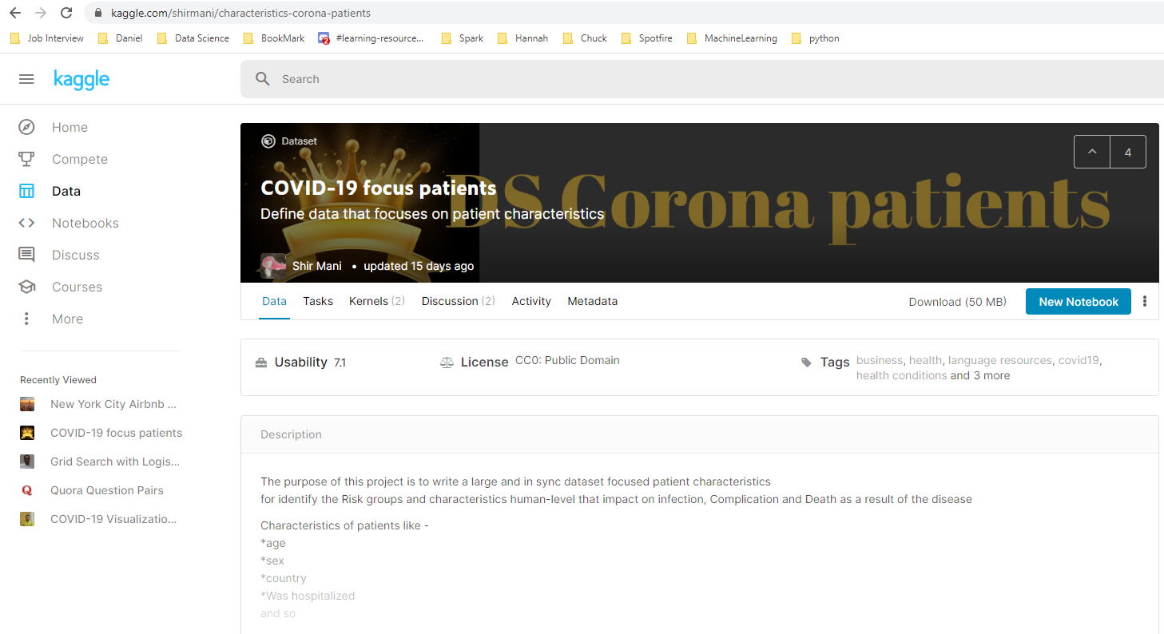

Slide 4
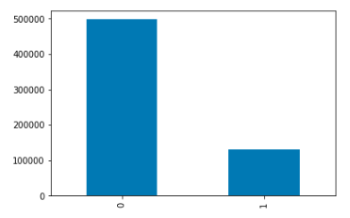
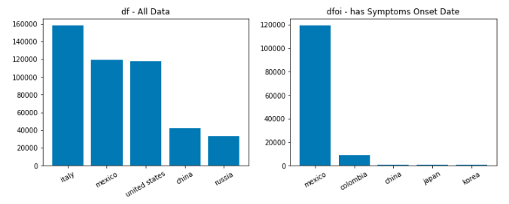
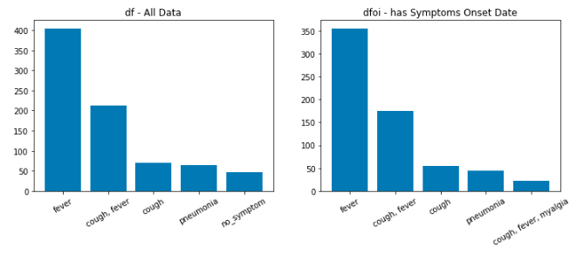
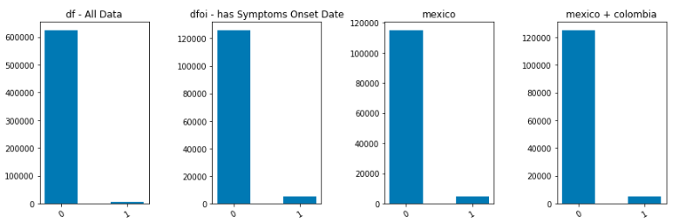
1. Pre-model Analysis: process and visualize data; get insights of features and target.

Slide 5
2. Problem definition: what’s the problem, how to resolve it.
1). We will classify the data into two parts: survival or death of patient health outcome
Create a label "Death“
Transform other data into features, like patient's age, gender, country, region, symptoms onset days, background disease.
2). We will apply classification metrics like log-loss, ROC AUC, recall and precision to evaluate model performance.

Slide 6
3. Feature engineering:
1). Background disease counts (from 0 to many)
2). Symptoms counts (from 0 to many)
3). Days onset (from symptoms onset date to last date, or to deceased date if available)
4). Days confirmed ( from confirm date to last date, or to deceased date if available)
5). Gender (male 2, female 1, missing 0)
6). Age (if missing use average)
7). Smoking (non-smoker 0, smoking 1)
8). Treated (hospitalized 3, hospital or clinical 2, home isolation 1, else 0)

Slide 7
4. Modeling (model selection):
Random Forest:
train roc_auc_score: 0.9520
valid roc_auc_score: 0.7054
Logistic Regression (balanced + SMOTE):
train roc_auc_score: 0.8963
valid roc_auc_score: 0.8963
Logistic Regression (balanced):
train roc_auc_score: 0.8976
valid roc_auc_score: 0.8977
Logistic model hyper parameter tuning on C, solver, class_weight, then selected :
C = 1000,
solver = 'newton-cg’,
class_weight = 'balanced'
Logistic Regression (SMOTE):
train roc_auc_score: 0.8963
valid roc_auc_score: 0.8963
Logistic Regression (unbalanced, no SMOTE):
train roc_auc_score: 0.5688
valid roc_auc_score: 0.5670

Slide 8
4. Modeling (Logistic: feature selection):
train roc_auc_score valid roc_auc_score
gender, age, treat: 0.8449 0.8438
bg_disease_cnt, days_onset, age, treat: 0.8933 0.8944
bg_disease_cnt, days_onset, days_confirmed, age, treat: 0.8933 0.8981
bg_disease_cnt, symptoms_cnt, days_onset,
gender, age, treat, smoke: 0.8946 0.8957
e) symptoms_cnt, days_onset, days_confirmed: 0.7705 0.770
f) bg_disease_cnt, symptoms_cnt, days_onset,
days_confirm, gender, age, smoke, treat: 0.8963 0.8963
Results from model ( f ) of Final Test Data:
Accuracy: 0.89 ROC AUC Score: 0.9000
Precision: 0.27 Confusion matrix: [[30353, 3927]
Recall: 0.91 [134, 1434]]
f1-score: 0.41

Slide 9
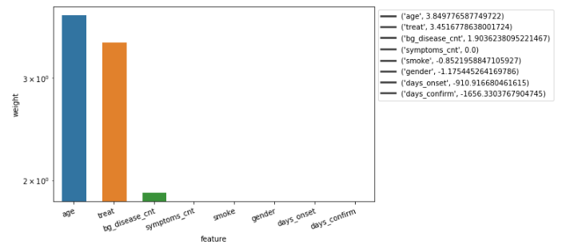

5. Post-Modeling:
Logistic model is stable across train, valid, and test data;
Recall is high (0.91) so it’s good for awareness; Precision is 0.27, so don’t worry too much from the positive prediction;
Age, Treatment Status, Counts of background disease are positively associated with Death;
Days (since) symptom onset and Days (since) confirmed negatively associated with Death
p = P(Y=1) = $\frac{1}{1+e^{−(b_{0}+b_{1}X1+ b_{2}X2 +…+b_{8}X8 )}}$

